Slide 1
EZ | PC
Peter Sou & Betsy Avila
Fall21-CSE111

Slide 2
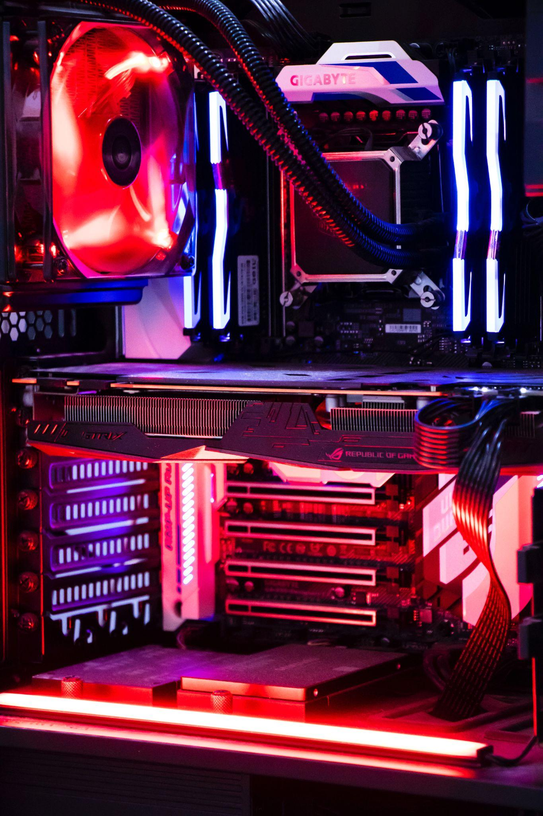
Introduce PC Building to Beginners
Build a Custom PC
List will be built for the user
User can share build with a friend
User can choose PC parts based on type: Productivity, Gaming, or Workstation
The internal builder will make sure parts are compatible with each other, giving a final list and estimated total price
User can share builds with other friends via email
1
2
3
Photo by sadeq shahsvan on Unsplash

Slide 3
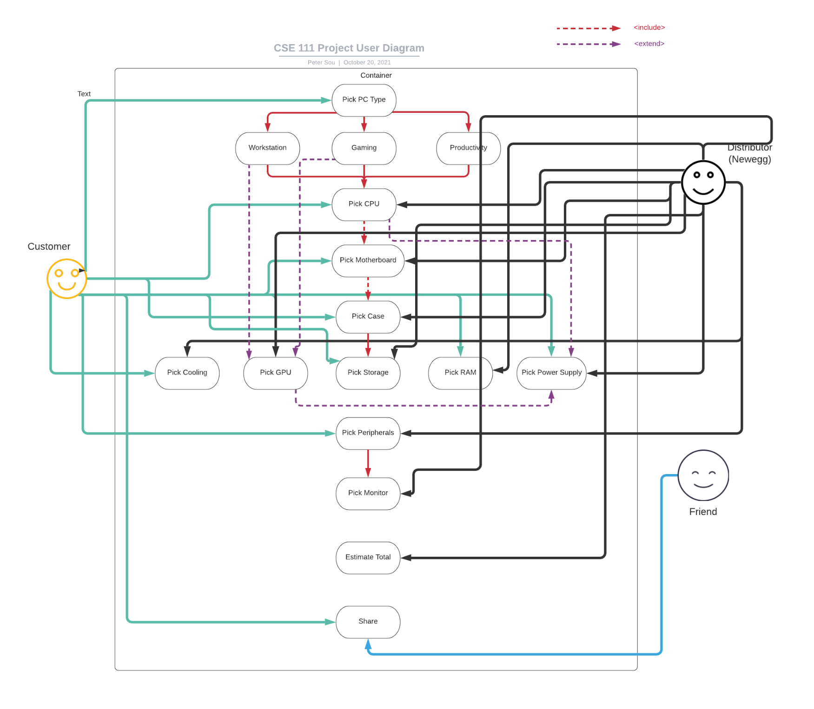
User Case Diagram

Slide 4
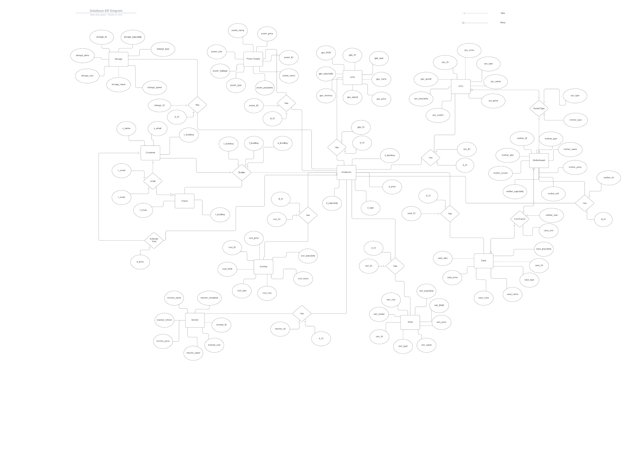
E/R Diagram

Slide 5
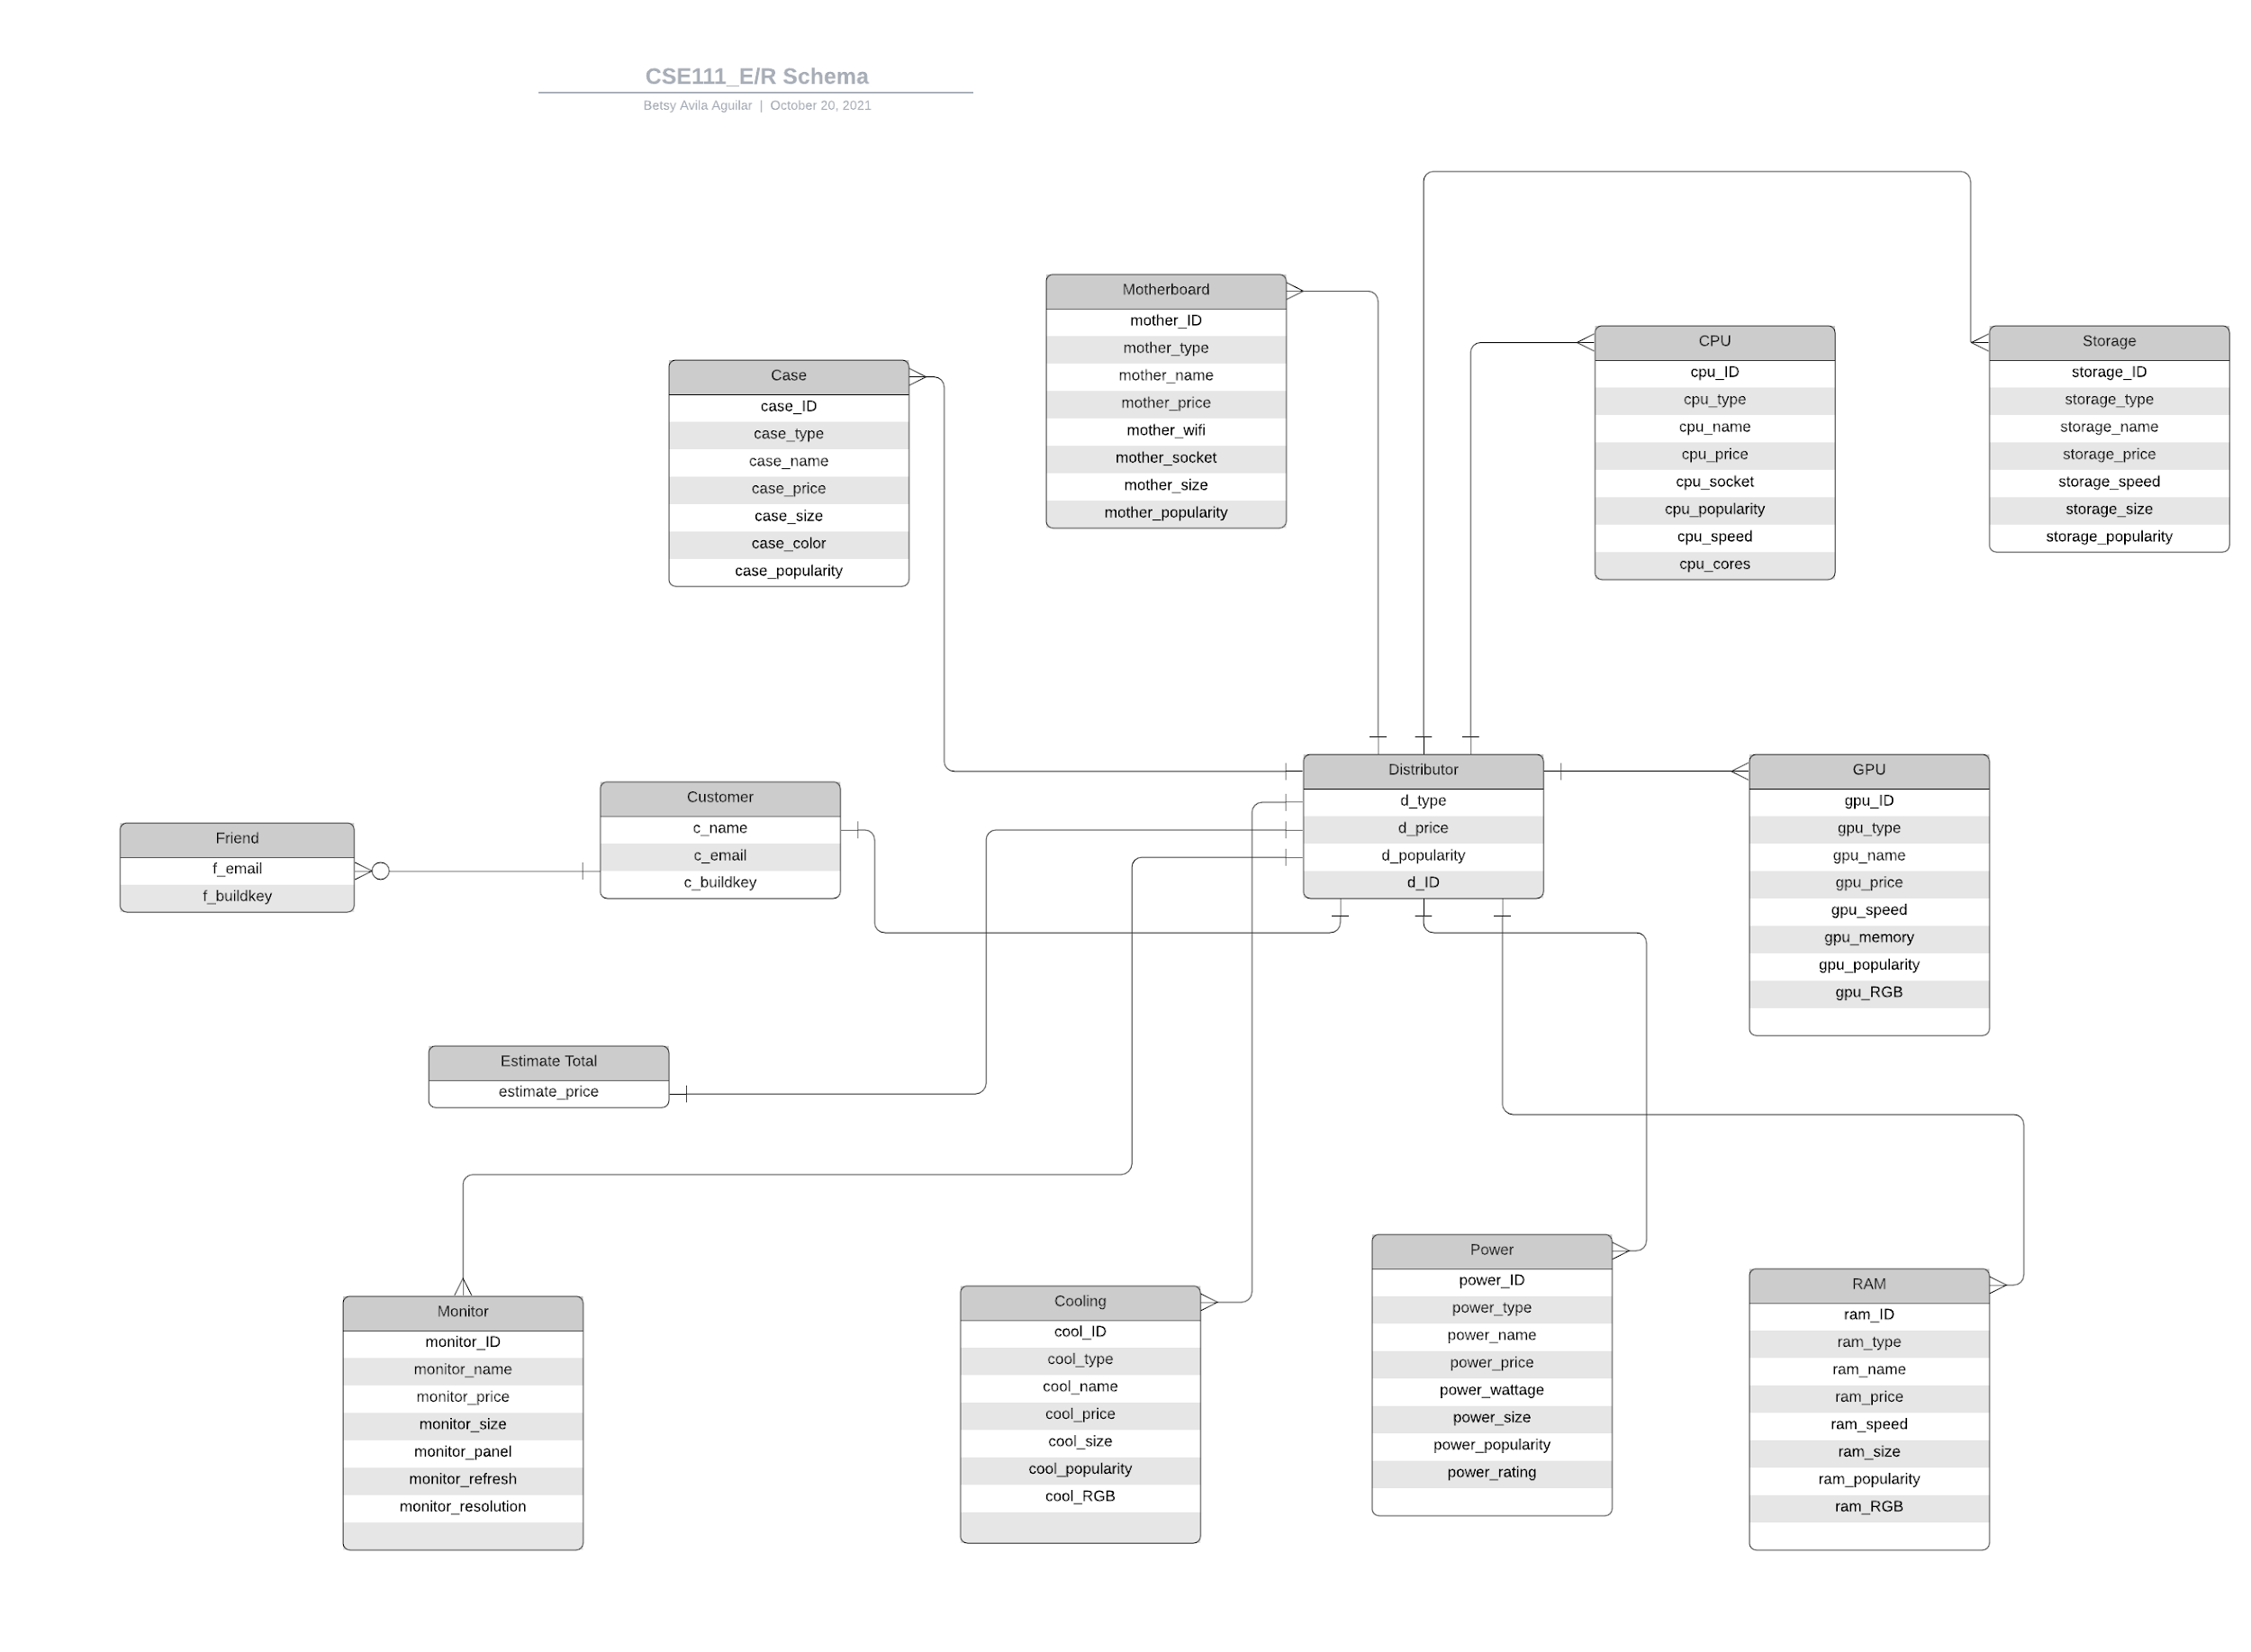
Relational Schema

Slide 6
Credits
Special thanks to all the people who made and released these awesome resources for free:
Presentation template by SlidesCarnival
Photographs by Unsplash

Slide 7
Thanks!

